Slide 1

Products for Carrier Ethernet Synchronization
DataEdge, Dublin, May 19, 2010

Slide 2
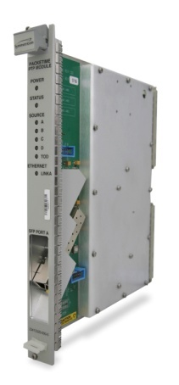

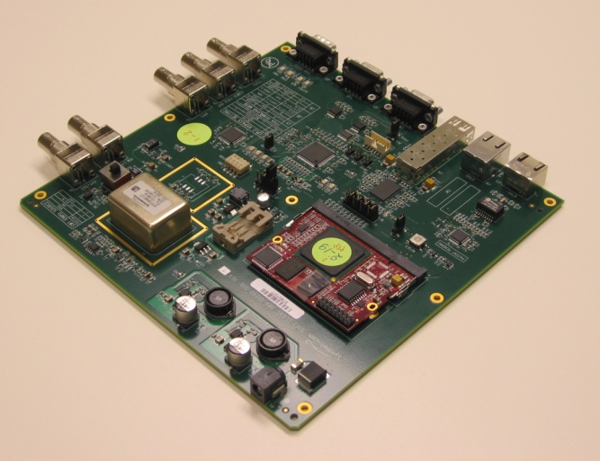
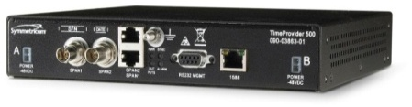

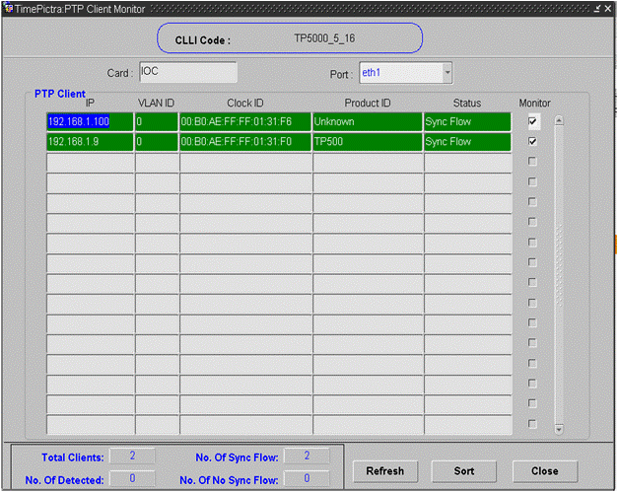
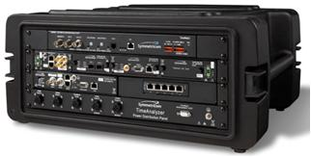
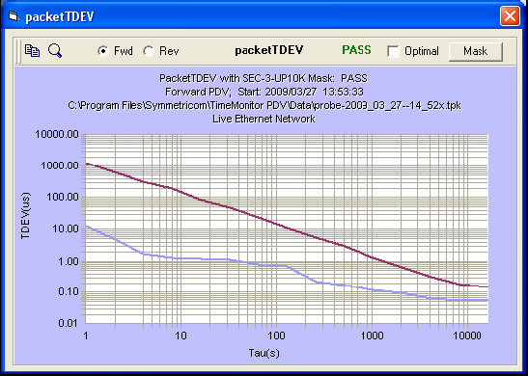
A Complete Sync Portfolio
GrandMaster Clocks
  TP5000
  SSU-2000 PTP Blades
Clients
  TP500 Stand-alone Client
  SCi Embedded Software Clocks
  SCf Embedded Femtocell Clocks
Management
  TimePictra Servers
  TimeScan
Network Engineering and Perf Monitoring
  TimeAnalyzer
  TimeWatch Probe
  TimeMonitor

Slide 3

Overview
GrandMaster Clocks
    SSU2000 PTP Blades
    TP5000
Clients
    TP500 Stand-alone Client
    SCi2000 Embedded Software Clock
    Operational SLA
Management Platform TimePictra 4.0
Network Engineering and Performance Monitoring
    TimeAnalyzer
    TimeWatch

Slide 4
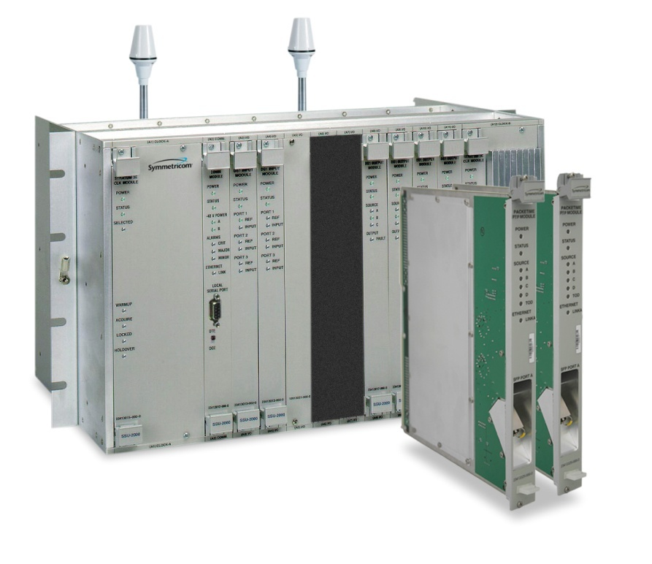
SSU 2000 PTP Blade Features
SSU 2000 System Release 6.0
  IEEE 1588-2008 Grandmaster
  Single SFP 100/1000BT port
  Full HW Redundancy
  Up to 125 Clients Blade
  Unicast /Telecom Profile
  Dynamic Reservations
  VLAN Support (up to 4 VLANs)
  TL1 and CLI Management
  “Bookend” Solution with TP 500 Translator

Slide 5
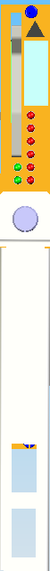
Card Level Redundancy
Port Redundancy
Card Redundancy
Facility Redundancy
Automatic or Manual Switching
No Bonding
Same IP address
PTP Blades
Ethernet Router/Switch
192.168.4.3
192.168.4.3
Port, facility, and
module protection.
1st blade is active,
2nd blade is standby.
H/W Protection
Active
Standby

Slide 6
Slave Locking Diagram
Slave Oscillator is free running during acquisition and qualification (drift is due to aging slope)
Freq
Acquisition
Establishes sync flow and determines initial offset
Qualification
Monitors sync packet stability to qualify Master
Tracking
“Tunes” the slave oscillator to the grand master
Locked
Oscillator is now locked to the grand master and will begin long term tracking

Slide 7
Slave Behavior During Master Failover
Freq
Master #1 fails
Locked to Master #1
Acq, Qual, & Track to Master #2
Locked to Master #2
Scenario 1: Slave switches to a back-up Master. Potential service impact while slave is out of lock while it acquires and tracks to the new Master reference frequency.
Freq
Active Master card fails - standby takes over
Locked to Master
Slave remains locked during hardware redundancy failover
Scenario 2: Slave remains locked during Hardware redundancy switching failover of the Master. Hardware redundancy protects NGN services.

Slide 8
TP 5000 Release 1.1 Features
Release 1.1
  IEEE 1588v2 GM
  REdundant IOC
  Quartz and Rubidium Options
  GPS and/or E1 Inputs
  10MHz/1pps Outputs
  -48VDC Power (Redundant)
  Port Bonding
  Up to 500 Clients/Port
  Unicast /Telecom Profile
  Dynamic and Static Reservations
  VLAN Support (up to 16 VLANs)
  SNMP and CLI Management

Slide 9
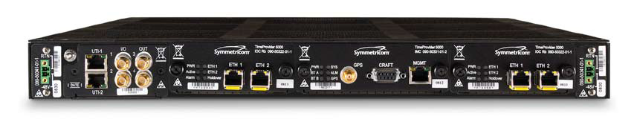
Release 1.1 Hardware
LEDs
LEDs
E1
Ports
LEDs
Ethernet
Mgmt Connector
-48v DC
Power
-48v DC
Power
UTI
Ports
DE 9
Craft Interface
Optional IOC Slot
GigE PTP
Ports
(Optical /Electrical)
10MHz/1pps
Ports
GPS
1 RU Package
ETSI Compliant
Dual –48v DC Power
Single IOC
2x E1 Inputs
2x 2048MHz Inputs
2x 10MHz/1pps Outputs
2x GigE PTP Ports/IOC
1x L1 GPS Inputs/ IMC
1X Ethernet Mgmt Port/IMC
1X DE9 Craft Port/IMC
6 LEDs/ IOC and IMC
Optional IOC Slot (Rel 1.1)
Optical/Electrical SFPs

Slide 10
TP 5000 Redundant IOCs
Redundant IOCs
  Independent ports on each IOC
  Must have different subnets
  Automatic or Manual Switching
Blank IOC Face Plate
192.168.4.3
192.168.5.3
192.168.4.3
192.168.5.3
Ethernet Router/Switch
Same IP Address
Same IP Address
H/W Protection
Active
Standby

Slide 11
TP 5000 Release 1.2 Features
Release 1.2
  Hybrid Communication
  Multicast Communication
  2-Step Clock
  T1 I/Os
  Additional TimePictra Support

Slide 12
TP5000 Roadmap
 |  | Mainstream | Releases
Q1 CY'10 | Q2 CY'10 | Q3 CY'10 | Q4 CY'10 | Q1 CY'11 | Q2 CY'11
 | Release 1.2 |  | Release 2.0 |  | Release 3.0
 | T1 Inputs and Outputs |  | PTP o/Layer 2 (Annex F) | Edge Server | Galileo Support
 | Hybrid/Multicast |  | Config Input Priorities | Scalable GM | GLONASS Support
 | 2- Step Clock |  | BC/Virtual GPS | VGPS | Indoor GPS
 |  |  | Enhanced PTP Metrics |  | Addt'l TimePictra Support
 |  |  | Soft Client Management |  | NEBs Chassis
 |  |  | Web Browser |  | Port ExpaNsion Module
 |  |  | Addt'l TimePictra Support |  | UTI/DTI Ports
 |  |  | Active/Active IOCs |  | 10MHz/1pps Inputs
 |  |  | GM + NTP Server |  | IPv6
 |  |  | 255 VLANs
 |  |  | 1PPS/TOD
 |  |  | 1.2 PCRs
 |  |  | Config Storage
 | Beta: Feb 2010 |  | Beta: Oct 2010 |  | Beta: Apr 2011
 | FCS: Mar 2010 |  | FCS: Nov 2010 |  | FCS: May 2011
 | GA: Apr 2010 |  | GA: Dec 2010 |  | GA: Jun 2011

Slide 13
Overview
GrandMaster Clocks
    SSU2000 PTP Blades
    TP5000
Clients
    TP500 Stand-alone Client
    SCi2000 Embedded Software Clock
    Operational SLA
Management Platform TimePictra 4.0
Network Engineering and Performance Monitoring
    TimeAnalyzer
    TimeWatch

Slide 14
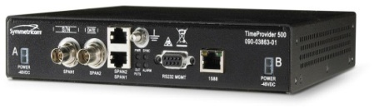
TP500 Stand-alone Client
IEEE 1588v2 Compliant
1 RU Package
OCXO
Inputs/Outputs
1x100 Mbps Ethernet Inputs
2x E1/2.048 Outputs
2x T1/1.544 Outputs
2x BNC or 2x RJ 48
Networking Features
Unicast/Telecom Profile
DHCP
VLAN ( x1 VLAN)
Acceptable Master (compares announce messages to choose best master)
Standards
G.8261 Compliant
G.703/9 Compliant
G.823 Compliant
PTP Messaging Flexibility
One Step sync (no need of Follow-up msg)
Configurable 32 pps, 64pps, 128pps
Default = 64 packets/sec
Management
CLI Management
1 serial and up to 5 telnet sessions
SW Upgrade during operation

Slide 15
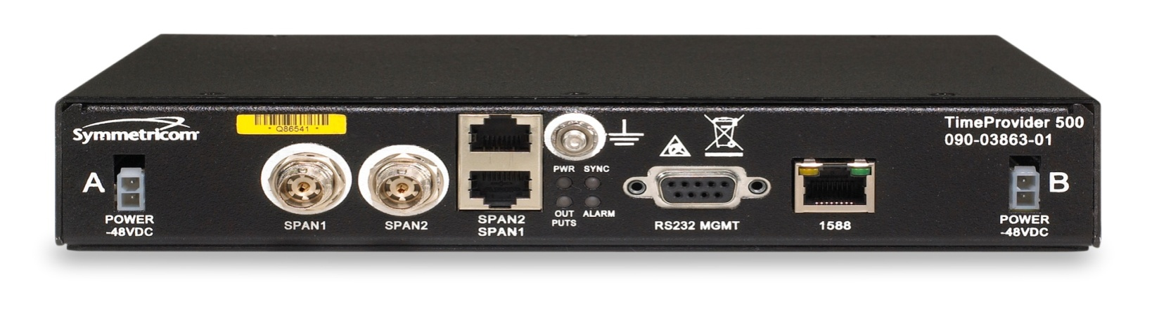
TP500 I/Os
-48v DC
Power
Combined
PTP Ethernet
Mgmt Port
T1/E1
BNC Ports
LEDs
T1/E1
RJ 48 Ports
DB 9
Craft Interface
1 RU Package
Single -48vDC Power Supply
2x E1/2.048 Outputs or
2x T1/1.544 Outputs
1x DB-9 Craft Port
1x100 Mbps PTP/NMS Port

Slide 16
TP 500 Release 2.0 Features
Dual -48vDC Power Connectors
10MHz/1pps Outputs
Telnet Security
SNMP Proxy Management via TP 5000
DHCP Support
IPPM
xDSLSupport
TOD and Phase Support
TimePictra Management

Slide 17
Embedded Software Clocks
SCi2000 HW/SW Architecture
Multi-standard Software Clocks
1588, SyncE, E1/T1, GPS, UTI (J.211)
Same world’s best algorithms as TP500
Addressing the NEM Market: Router/Switches, 2G/3G/4G Base stations
Available on Freescale Processors and Wintegra NPU’s today
Clock Control
1588 Clock Recovery Algorithms,
Metrics,
Management
SSM
UTI
ESMC
  PTP Protocol
UDP
Optional
Timestamp Engine
SW
IP
HW
E1/T1
PHY
UTI
PHY
Ethernet MAC
FPGA
Optional
Timestamp Engine
Optional
Timestamp Engine
Input Ref Monitoring, DCO, Jitter/Wander Filter, Holdover, Osc drive, Timestamp Engine
Ethernet PHY

Slide 18
Router/Switch Mode
Target Architecture
1588 Port
Ethernet PHY/MAC
Board CPU/NPU
running SCi2000 SW
Embedded TS Engine (Optional)
TS Engine
(Optional)
TimeStamp
Engine
(optional)
Clock Control
& CPU i/f
Line Cards/Ports
Hardware Assist Functions
(FPGA Blocks)
Ethernet PHY
Output Clock
2MHz, 1.5 MHz
25 MHz, 10 MHz, 1pps
SyncE Clocks
25/125 MHz
Ethernet PHY
Input
Monitoring
& Selection
DPLL
Jitter
Wander
Filter
Synthesizer
T1/E1 LIU
Free-Running
OCXO or
TCXO
T1/E1 Clocks
2.048/1.544 MHz
T1/E1 LIU

Slide 19
Base Station Mode
Target Architecture
GPS Receiver
Board CPU/NPU
Embedded
TS Engine
(Optional)
OutputClock
1588 Port
Ethernet PHY/MAC
TimeStamp
Engine
(optional)
Clock Control
& CPU i/f
TS Engine
(Optional)
Line Cards/Ports
VC-OCXO or
VC-TCXO
Clock
Multiplier
Ethernet PHY
SyncE Clocks
25/125 MHz
Ethernet PHY
Input
Monitoring
& Selection
T1/E1 LIU
Analog Loop
Control
Analog
Loop
Filter
T1/E1 Clocks
2.048/1.544 MHz
T1/E1 LIU
Hardware Assist Functions (FPGA Blocks)

Slide 20
Reference Design
Interfaces
  Ethernet RJ45, SFP
  E1/T1 Output
  10 MHz, 1 pps out
  Programmable Output clock
  External OCXO i/f
FPGA
PowerQuicc II Pro
MPC8313

Slide 21








Operational Sync SLA
NETWORK
CENTRAL
OFFICE
GPS
BTS with embedded 1588 client
Client / Slave
Legacy BTS
Transparent Clock
Standalone Client / Slave
Client Clock (in router/switch)
TimeProvider 5000
(NodeManager)
Boundary Clock
Embedded Client / Slave
Network visibility through OSS / mgmt system from NodeManager
Notes:
We are focused on the telecom

Slide 22
Sync SLA Performance Categories
Client performance is driven by the end application
1 - 5 µs
Phase & Time Accuracy
1
LTE/MBMS
Overall Client Health
Output TDEV Estimate (ns) (for phase, time)
Output MDEV Estimate (ppb) (for frequency)
Category determination engine
LTE/WiMax TDD
Pseudo Wire Application
Phase Accuracy
E1/T1, G. 823 / G. 824
2
Sync
~ 2 µs
Traffic
~ 18 µs
Wireless Mobility
Frequency Accuracy
3
1 to 15 PPB
LTE / UMTS FDD
Frequency Division Duplex
Frequency Accuracy
4
~ 100 PPB
Femtocell

Slide 23
Sync SLA: Client Performance Metrics
Metrics
Forward Flow Transient-free (out of 900s)
Forward Flow Transient-free (out of 3600s)
Reverse Flow Transient-free (out of 900s)
Reverse Flow Transient-free (out of 3600s)
Forward Flow Operational MinTDEV (ns)
Forward Flow Operational MAFE (ppb)
Reverse Flow Operational MinTDEV (ns)
Reverse Flow Operational MAFE (ppb)
Forward Maximum PDV (µsec)
Forward InterPkt Jitter (µsec)
Reverse Maximum IPDV (µsec)
Reverse InterPkt Jitter (µsec)
Minimal Round Trip Delay (µsec)
Operational Temperature Max (deg C)
Operational Temperature Min (deg C)
Operational Temperature Avg (deg C)
5 Minute Temperature Stability (mdeg C)
60 Minute Temperature Stability (mdeg C)
Packet Availability
Packet Stability
Overall Client Health
Output TDEV Estimate (ns)
Output MDEV Estimate (ppb)
Performance Calculator Engine
Network Jitter (SLA)
Temperature Stability

Slide 24
Metrics and SLA
Monitoring & management
    Gives key insights into network timing performance
    Simplifies the key factors contributing to client performance
    Drill down details for understanding performance ‘bottlenecks’
    Network mapping give visibility into trouble spots
    Time trending give visibility into trouble areas
Leverages clients in the network as ‘probes’
Deep insights into the overall network’s operation as well
Network level monitoring & management are essential for carrier class packet timing solution

Slide 25
Overview
GrandMaster Clocks
    SSU2000 PTP Blades
    TP5000
Clients
    TP500 Stand-alone Client
    SCi2000 Embedded Software Clock
    Operational SLA
Management Platform TimePictra 4.0
Network Engineering and Performance Monitoring
    TimeAnalyzer
    TimeWatch

Slide 26
TimePictra 4.0 – New Features
New Products Support
  SSU-2000 6.0 PTP Blade
  TimeProvider 5000 1.1 full FCAPS
  TimeProvider 500 2.0 enhanced monitoring
  IEEE 1588 Client Monitoring
Enhancements over 3.x
  Oracle 10g DB & App Server
  HP-UX 11i v2 support on PA-RISC/Itanium processor
  SSU-2000 configuration backup & restore
  SSU-2000, TimeProvider, TimeSource revision control
  TimeProvider 500 batch firmware download
  SSL support for WEB
  Up to 2500 NEs with dynamic sizing for 500/1500/2500 NEs
  SNMP (Northbound) support available in std. package
Symmetricom Confidential

Slide 27



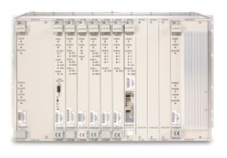
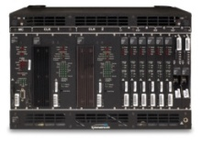



Management for TP5000 – 1.1 & TP500 – 2.0
Web Client
Web Client
Web Client
Web Client
TCP/IP Network
TimePictra Server
FCAPS
TCP/IP Network
TL1
TL1
SNMP
SSU2K - PTP
TimeHub - PTP
SNMP
TimeProvider 5000
TimeProvider 5000
1588 mgmt msg
1588 mgmt msg
1588 mgmt msg
1588 mgmt msg
TimeProvider 500s
TimeProvider 500s
TimeProvider 500s
TimeProvider 500s
In addition to CLI only (one at a time), Now all TP500’s are manageable by NMS, through TP5000

Slide 28


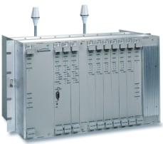
PTP Communication
GrandMaster Server
Client
PTP Messages
TP5000
TP500
PTP Messages
TP500
SSU2K – PTP blade
  Event messages
    Sync messages
    Delay request messages
  General messages
    Announce messages
    Delay response messages
    Signaling messages
Symmetricom Confidential

Slide 29
Management Protocols
GrandMaster Server
  SSU2K PTP blade: TL1
  TP5000
    SNMP (v2c & v3)
    CLI (Telnet , SSH)
Client
  TP500
    CLI (Telnet , SSH)
OSS
TimePictra
SNMP Traps
SNMP
TL1
TP5000
SSU2K
PTP Messages
PTP Management
Messages
PTP Messages
TP500
TP500
Symmetricom Confidential

Slide 30


PTP Network Management
TimePictra / Performance Monitoring/OSS
TimeProvider 500
SNMP
T1/E1
SNMP
TimeProvider 5000
(Node Manager)
VLAN 1
1588 PTP
TimeProvider 500
TL1
IP/Ethernet
VLAN 2
T1/E1
1588 PTP
TimeProvider 5000
(Node Manager)
VLAN 3
TimeProvider 500
T1/E1
1588 PTP
VLAN 4
SSU2K w/ PTP
(Node Manager)
TimeProvider 500
VLAN 6
VLAN 5
T1/E1
TimeProvider 500
TimeProvider 500
T1/E1
T1/E1
Symmetricom Confidential

Slide 31
GMC Node Manager Functions
Client Management – Node Manager std compliant
  Common PTP Management
    NULL management message
    Acceptable master table message
    Clock description message
  Vendor specific PTP Management
    Autonomous message (alarms and events)
    Operational status
    Performance metrics
    Software upgrade
    Reset
Symmetricom Confidential

Slide 32
Overview
GrandMaster Clocks
    SSU2000 PTP Blades
    TP5000
Clients
    TP500 Stand-alone Client
    SCi2000 Embedded Software Clock
    Operational SLA
Management Platform TimePictra 4.0
Network Engineering and Performance Monitoring
    TimeAnalyzer
    TimeWatch

Slide 33

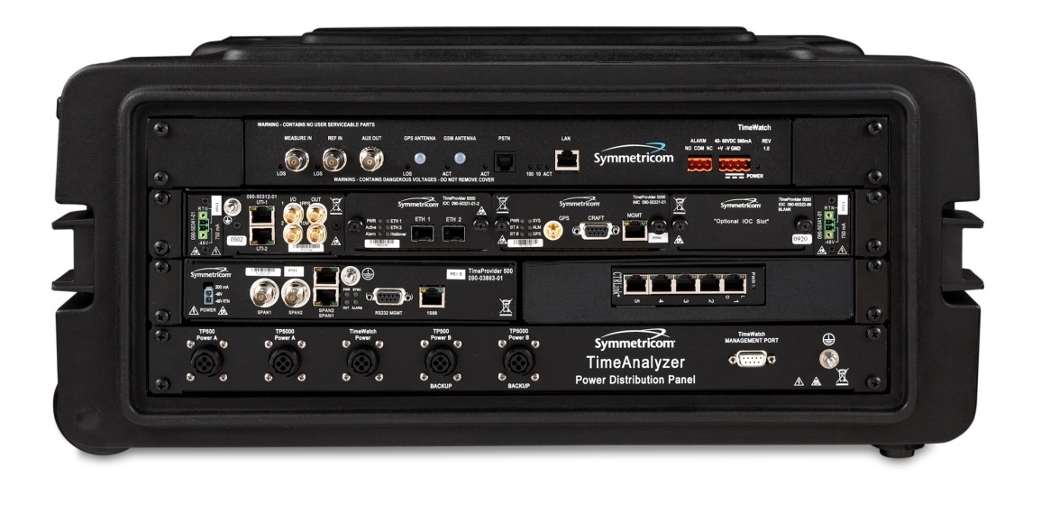
Fully Integrated Test Environment
Pre-configured and ready for testing
Bundled with TimeMonitor 3 PDV / Watch
Packet timing measurement and analysis
Build in TDM Wander tester and analysis
Rubidium clock configuration for superior clock performance
Build in Ethernet switch
Ruggedized enclosure box with AC power and accessories for simplification & portability
TimeMonitor PDV
TimeMonitor Watch

Slide 34
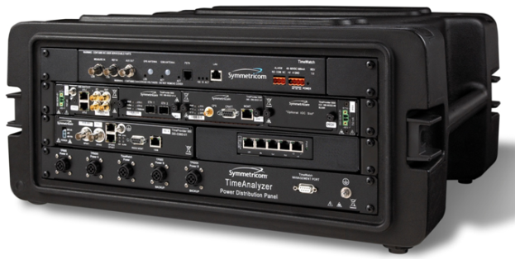
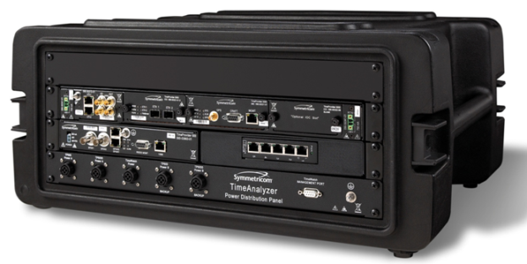
TimeAnalyzer - Versions
TimeAnalyzer 7500
  Packet synchronization measurement
  1588 readiness network analysis
  Physical sync layer measurement
TimeAnalyzer 7100
  Packet synchronization measurement
  1588 readiness network analysis

Slide 35
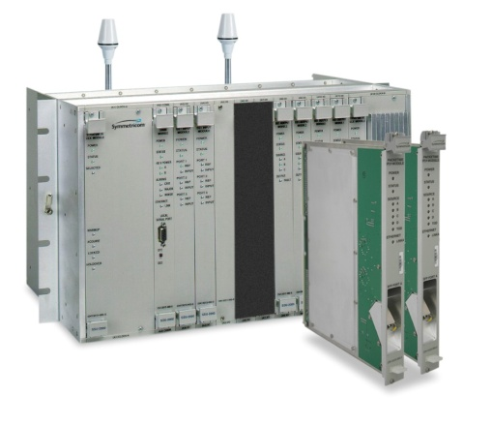




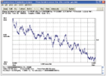
Where to measure - Network
PTP Grandmaster
PTP Client
ETH/IP
Switched Network
ETH/IP
2 MHz
Measures and analyzes
  Packet delay variation before or at client’s location
    Network suitability for good synchronization performance
    Client operational margin affected by network dynamics
  Frequency accuracy produced by client
    Frequency accuracy confirmation
TimeAnalyzer
PDV / Wander

Slide 36
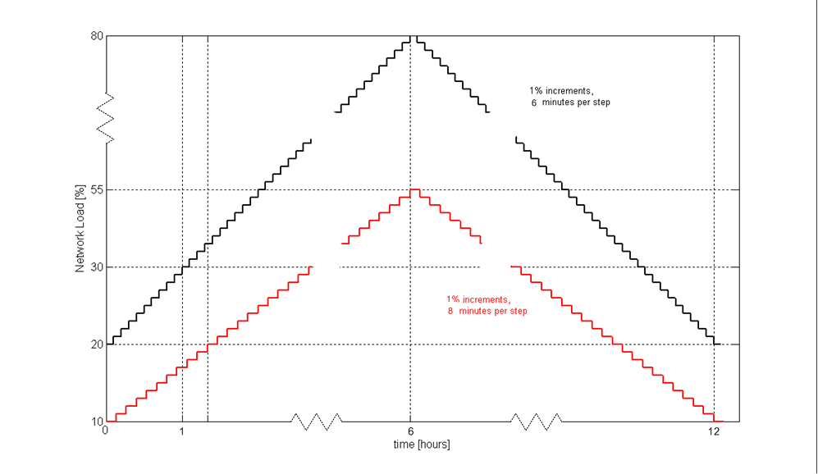


Where to measure - Lab
ITU G.8261 Test cases
Network simulation
NEM conformance tests
NEM Benchmarking
Application tests
Test of worst case scenarios
Client Qualification
Network
Simulation
Emulation
Traffic Profiles

Slide 37
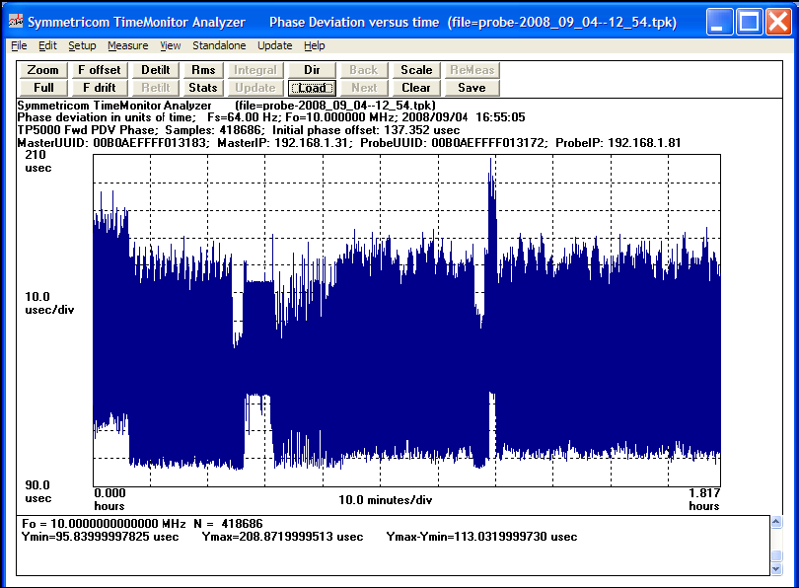
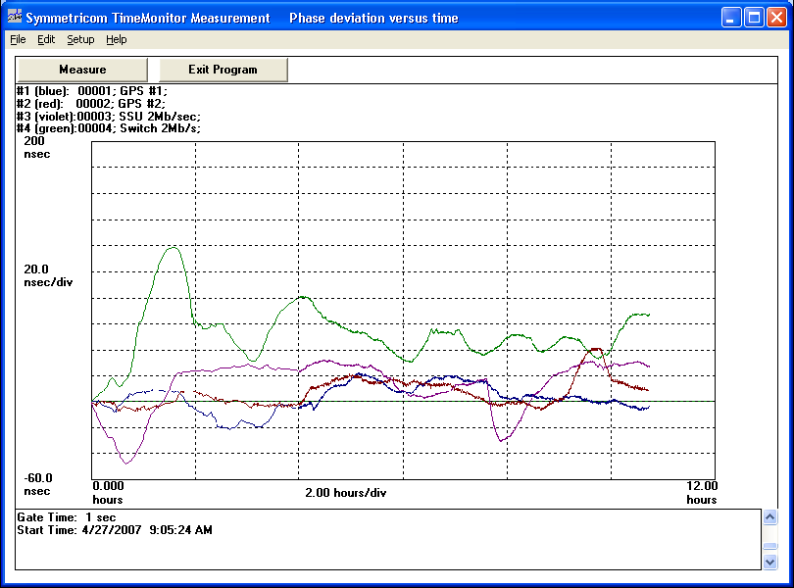
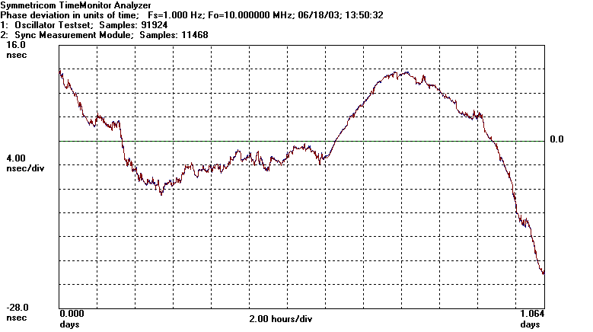
Key Features
Measurement
  Packet Timing (IEEE 1588 packet flow)
    Collect Packet Delay Variation (PDV)
    Real-time display and saved files
    Wide range of pkt/s rates
    File export
  Traditional Synchronization
    Collect Jitter and Wander (TIE)
    Real-time display and saved files
    File export

Slide 38
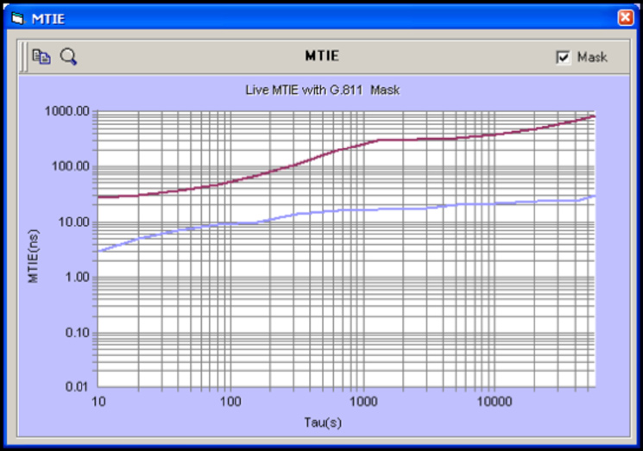
Key Features
Analysis
  Packet Timing (IEEE 1588)
    Data calculations
    (MinTDEV, bandTDEV,
    percentileTDEV, MAFE, MATIE)
    Packet Synchronization masks
    for PASS/FAIL indication
  Traditional Synchronization
    Data calculations
    (MTIE, TDEV, frequency deviation
    fractional frequency offset)
    Telecom standard masks for result
    validation (Telcordia, ANSI, ETSI,
    ITU-T)

Slide 39
Analysis – Computing & Comparison
PacketTDEV sync mask
Computed PacketTDEV

Slide 40






Metrics for PDV - predictors for how a PTP slave should perform
MAFE (Maximum Average Frequency Error
MATIE (Maximum Average Time Interval Error)
minTDEV - involves the selection of a single minimum delay packet
percentileTDEV – involves a set of minimum delay packets and averages them
bandTDEV
PacketTDEV – based on percentileTDEV and bandTDEV, indicator of freqency stability
PacketZTIE - same as the MATIE calculation, incorporates floor averaging, indicator of frequency offset

Slide 41
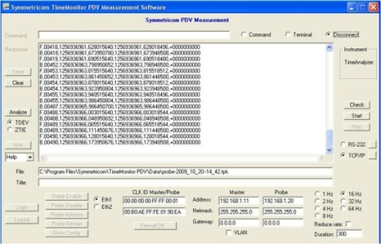

TimeAnalyzer Setup

Slide 42
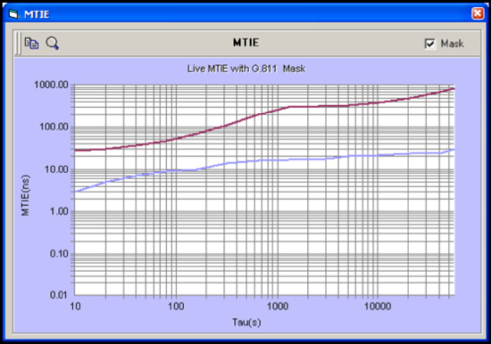

Key Benefits
All-in-One test tools
  Packet timing and Traditional synchronization
Portable test device
  Lab and field
Active 1588 client capability
Comprehensive measurement and analysis
  Advanced calculations
  Packet timing masks
Network profiling and qualification tool

Slide 43
Resources and Collateral
Web Content
  http://www.symmetricom.com/products/ieee-1588-ptp-solutions/ieee-1588-measurement-and-analysis-tools/TimeAnalyzer/
  Data Sheets
    TimeAnalyzer 7500 Datasheet
    TimeAnalyzer 7100 Datasheet
  Whitepapers
  FAQs

Slide 44
Thank You!

