Slide 1
SyncWatch Another True Story

Slide 2
Once Upon a Time in the North…
Scandinavian mobile operator moving to Ethernet mobile backhaul
New backhaul network interfacing with DWDM core
Backhaul equipment vendor already selected
2G / 3G Base stations in current install base require sync
Platform for LTE and future technologies
TDM sync chain to be broken as migration occurs
FDD mode used to communicate with mobile devices
Stable frequency required as reference to base stations
Stability required = 16ppb (long term)
Considering options:
Symmetricom Grandmaster & TP500 clients… or…
IEEE 1588 solution built in to backhaul network equipment….
….Which option is the right one to use???
?

Slide 3
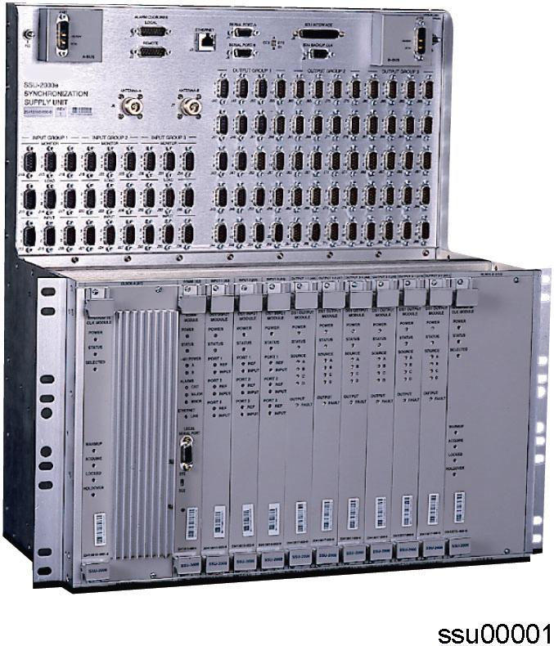
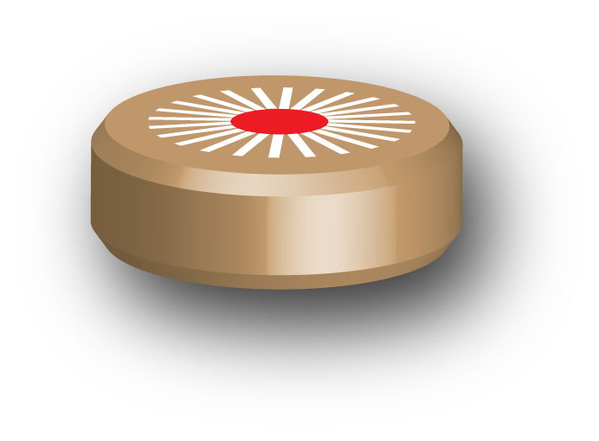
Setting up the Test Environment
Engineering test bed constructed
Two sites selected for packet clock trials
SSU2K, Master Packet Clocks, Clients
Max 6 Ethernet & 2 µwave hops between master & client
Embedded packet clock solution provisioned by vendor
Purchased TP5000 & multiple TP500’s from Chronos for evaluation
Chronos to commission and ensure correct operation
SSU2K
Native Eth. Radio
TP5000 PTP GM
TP500
????
????
Master Clock
Embedded Client

Slide 4
What do I Need to Test?
Initial setup of TP5000 & TP500
Ensure all is installed and working correctly
Initial indicators of performance in environment
Suitability of the network & PDV characterisation
Effects of changing QoS/CoS or bandwidth settings, etc. can be seen immediately – May take time to show effect in clients with OXCO
Effects of traffic loading, important
Hard data to go back to developers if problems occur
Frequency stability at base station inputs (TP500 & Embedded)
Ultimately, this is what matters
Base stations had E1/2.048 MHz input for sync
G.823 Sync + 16ppb requirement – ‘a non-standards based “standard”’
Effects of changes to network PDV
Long term stability over weeks of normal operation
How does SyncWatch help the above?

Slide 5
The 2230 probe – Connections Used
C: E1/T1
Mgmt Ethernet
Dry Relays
B: 64kHz-200MHz
50 ohm/High Z
Sync
inputs
Sync
output
DC (-48VDC)
A: E1/T1
D: 64kHz-200MHz
50 ohm/High Z
USB
RS-232/Craft I/F
E: Freq, 50 ohm
G: Ethernet
F: 1PPS
GPRS Antenna
Aux output
GNSS Antenna (e.g. GPS)

Slide 6
Provisioning PTP Solutions
SyncWatch Standalone mode
TimeMonitor
Software
Real time data / analysis
Live TIE / MTIE / TDEV
One to one tool with laptop
Live reporting of results for immediate interpretation
Easy to deploy GPS antenna
AUX Out provides PRC reference to PDV tester – extremely handy!
TimeMonitor Analyzer also useful for PDV data analysis
Sync performance data streamed live to TimeMonitor application
GPS
TP500
Probe
PDV Tester
Aux Out
Embedded Client

Slide 7
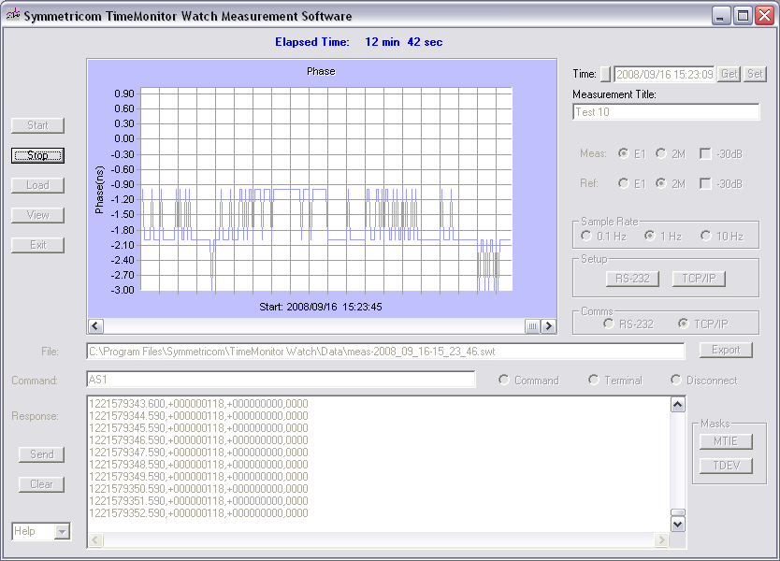
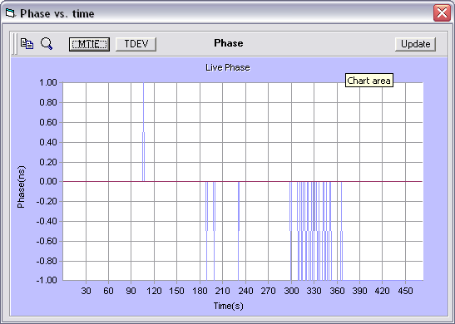
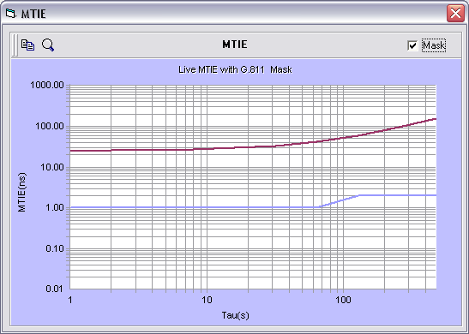
Standalone Testing
Simple set-up, connect then hit ‘Start’
Enter view mode to see MTIE/TDEV while still collecting data from probe
Phase plots can be imported into TimeMonitor Analyze for full mask based analysis
Live phase data displayed as it is received from probe
Phase / MTIE / TDEV View On The Fly

Slide 8
PTP Client Evaluation Setup
SSU2K
TP5000 GM
Master Clock
Native Ethernet Radio
2x Hops Max
Core Infrastructure
Multi-Service Switch
Test Environment
TP5000 and other Master Clock locked to SSU2K
3x Network hops until microwave
2x Microwave hops then multi-service switch
E1’s monitored at both PTP clients, reference is GPS
Embedded Client
E1 Out
TP500
E1 Out
GPS

Slide 9
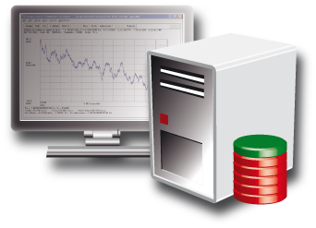
Long term monitoring of performance
SyncWatch Managed mode
TimeMonitor
Software
One to many system
Single server aggregates all sites data
Two sites in this trial – 100s possible
Monitoring and Alerting
Relevant ‘exception’ masks defined
If mask broke, could correlate this back to network events
Long term performance now being logged
Compared performance of TP500 and Embedded clients
Integrated with SNMP management system for alert reporting
SNMP
GPS
Server
Probe
GPS
Fixed & µwave
Network
Probe
Probe
GPS
Probe
Probe
External reference

Slide 10
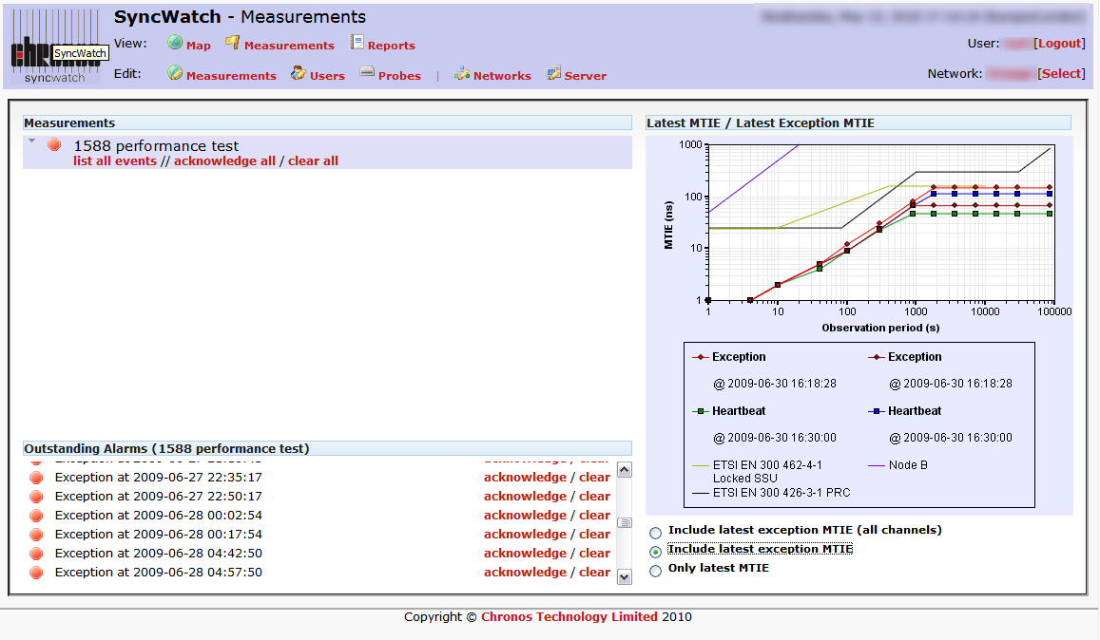
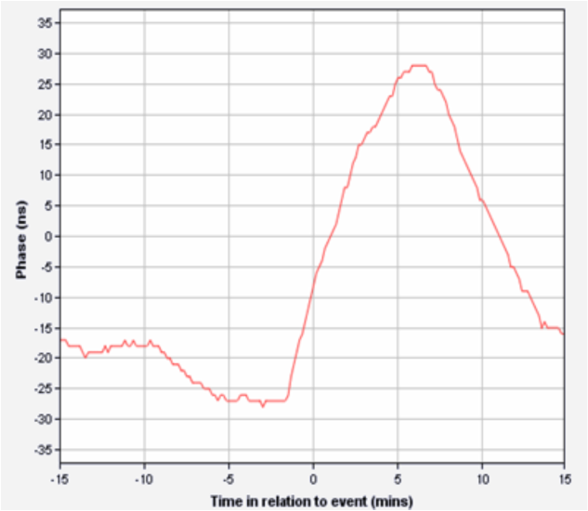
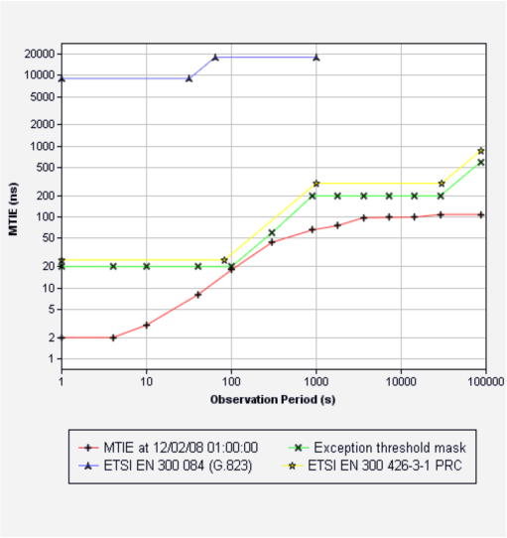
Server / Client Mode
Customer evaluated both solutions over 1 month
Normal and exceptional traffic conditions
Used SyncWatch graphs in their final report
Server holds performance data for all sites in the trial
Phase data for broken masks

Slide 11
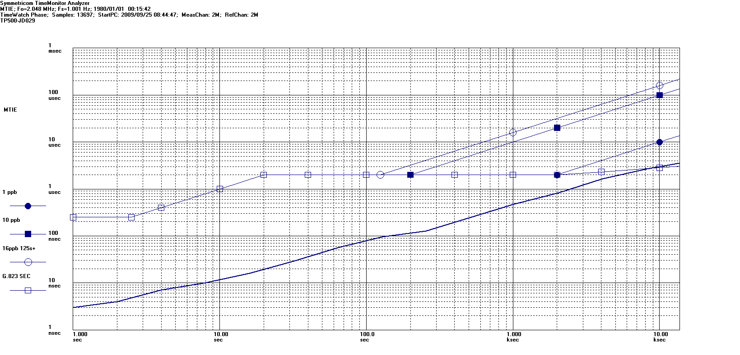
Chronos / Symmetricom Test Results
TP500 client performed to a high standard, with MTIE well inside G.823 and 16ppb masks.
TP5000 was also evaluated and the customer liked the product
Plot below taken from Chronos commissioning test, 2 microwave hops
MTIE Plot – TP500 – 4 Hour Commissioning Test

Slide 12
Who was Left Out in the Cold?
TP500 outperformed Embedded client under normal operation
Even though embedded solution employed transparent clocks at every node
Customer decided to go with Embedded Client solution, mainly based on cost, however….
… They were impressed with the TP5000 and wanted to keep sync master separate from traffic, looking to deploy multiple TP5000’s
Waiting for v1.2 release as this supports multicast PTP
Customer realised the importance of permanent monitoring
Ordered 15x SyncWatch Probe, SyncWatch Server & SNMP option
SyncWatch written in to deployment guidelines and to be installed at newly migrated sites in every region
‘Worst case’ sites selected – most radio hops from grandmaster
G.823 + 16ppb masks configured on SyncWatch Server – alarms forwarded to NOC if exception occurs
Pool of SyncWatch probes kept in central location to be used for emergency or ad-hoc testing

Slide 13
SyncWatch Monitoring in all Environments

