Slide 1
Microwave Path Alignment Tool Overview

Slide 2
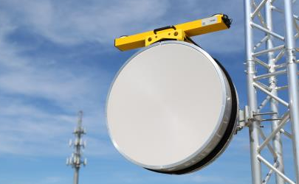
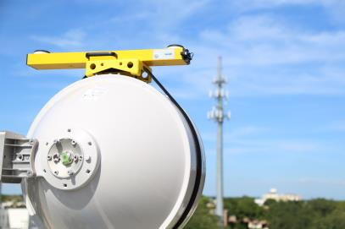
Microwave Path Alignment Kit
Overview
Microwave Path Alignment Kit
Latest Product Line
Features and Functions
Mounting
Operation
Target and Report
Models for Microwave:
1015 (AAT-15)
1008 (AAT-08)

Slide 3
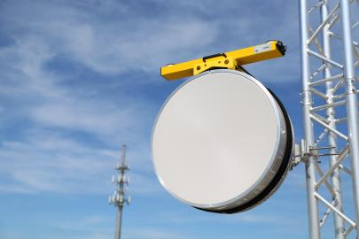
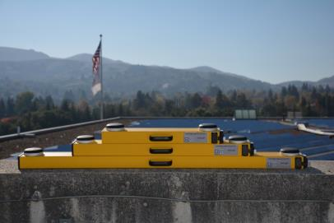
Microwave Path Kit Product Line
Models:
P/N 1015: 0.15° rms
P/N 1008: 0.08° rms
Features:
GPS and GLONASS
Best Accuracy
81% smaller in volume
55% lighter in weight
Weather and Shock Resistant
Durable Aluminum Housing
3 yr Manu. Warranty
No Moving Parts
RF Shielding
Multi-level Multipath filtering

Slide 4
MW Pathing Kit Basic Operations
Tech can use Link alignment data and program the AAT before arrival at tower
AAT should be turned on to let it locate its “pair”
At the tower, Tech starts up the AAT and lets it get azimuth on the ground BEFORE climbing
Tilt/Roll can be checked and calibrated in field if necessary (before climbing)
AAT is powered off and Tech climbs, set mount, insert AAT and power up, connect to Tablet

Slide 5
MW Pathing Operation Cont…
Choose mount position and attach mount to dish antenna
Power on AAT and get azimuth before placing AAT into mount
Allow AAT to find its “pair”
Once units link, position data shared through Tablets
Target values calculated and provided for alignment with ‘other’ side
Move Dish to Target values-lock down.
Capture final data to Path Alignment report
Manual entry possible for extremely remote areas

Slide 6
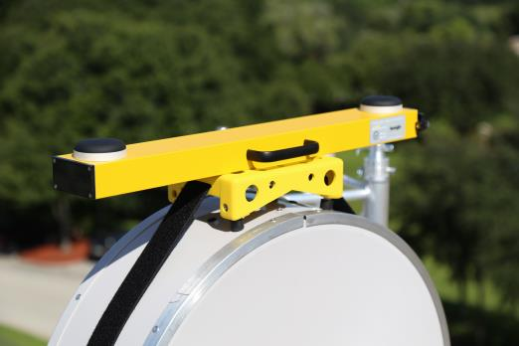
Alignment Tool Specifications
Power: Rechargeable LiFePO4 batteries
Operation time: 8-9 Hrs, (Charge: 1.5 hrs)
Dimensions: 22.7"x3.8"x1.7“
Weight: 4.5 lbs,
Water Resistant
Shock Resistant
Dust Resistant

Slide 7
Package Contents
The AAT product package contains the following items:
2- AAT (Tool)
2 AAT Hard Cases
2 Drum Mounts
2 Side Mounts
2 Ruggedized WiFi Tablets
Warranty Card (3yr)
Battery Charger
Laser Rangefinder-Height (Optional)

Slide 8
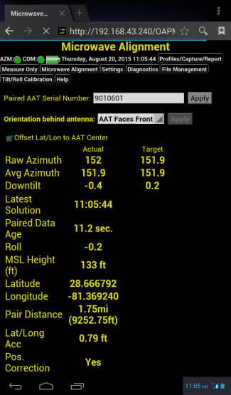
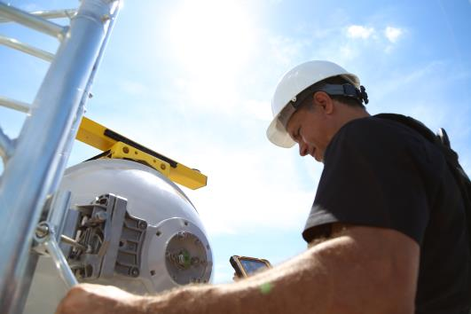
Microwave Target-on Tablet

Slide 9
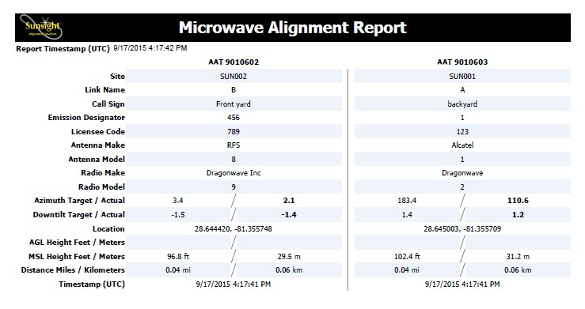
Microwave Path Alignment Report

Slide 10
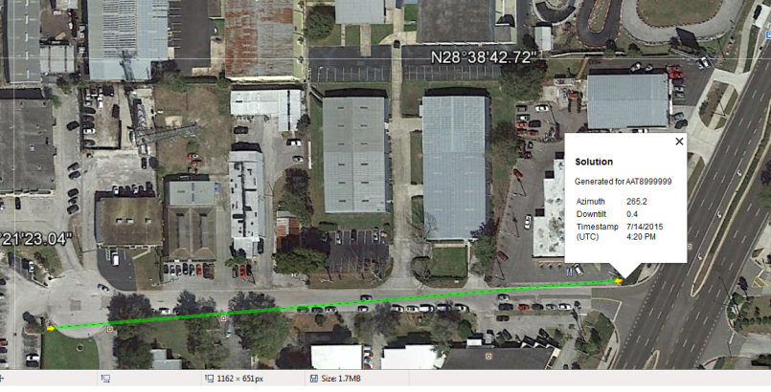
Microwave Path Link example

Slide 11
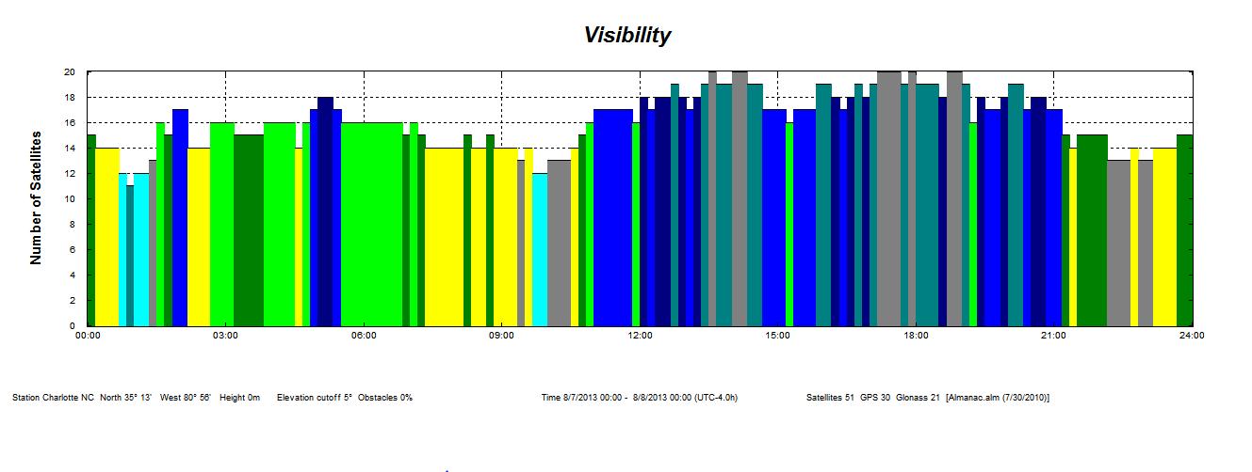
Sunsight Advantage (GPS vs GPS and GLONASS) Latest Technology -Twice the Satellites now available

